Slide 1

Mrs. Shwetambari Borade
SHAH & ANCHOR KUTCHHI ENGINEERING COLLEGE
DEPARTMENT OF CYBER SECURITY
ACE GAURD
(Standard Encryption Decryption using various algorithms)
Under the guidance of
Group members
Shruti Dantala
Shivam Pandit
Rutuja Umap

Slide 2
Index :-
Introduction
Proposed Methodology
Technology Stack
Flowchart
Working
Future Scope

Slide 3
Introduction :-
Nowadays, SMS is a common mode of communication among mobile phone users.
It is a type of text messaging service that can be used by user to send personal information, email notification, transaction or bank details etc.
These information are sensitive and need to be protected from malicious attacks.
By using one of the cryptographic algorithm i.e. AES, we are encrypting the message, image before sending it using an android application and decrypting the encrypted message at the receiver end.

Slide 4
Proposed Methodology :-
It involves study of various cryptographic algorithms and implementing the algorithm that best serves our purpose. In our project we use AES as the cryptographic algorithm to encrypt the message and images.

Slide 5
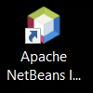
Technology Stack :-
We used;
Apache NetBeans for frontend
Java Programming language.

Slide 6
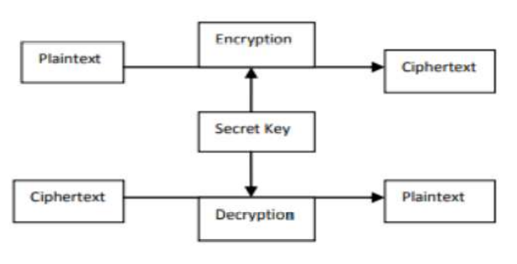
Flowchart :-

Slide 7
Working :-
We are using AES, a secure encryption algorithm which is a symmetric encryption algorithm. AES encryption is used by U.S. for securing sensitive but unclassified material.
It uses the same key for encrypting and decrypting, So the sender and receiver must know about it.
AES is block cipher capable of handling 128 bit blocks.

Slide 8
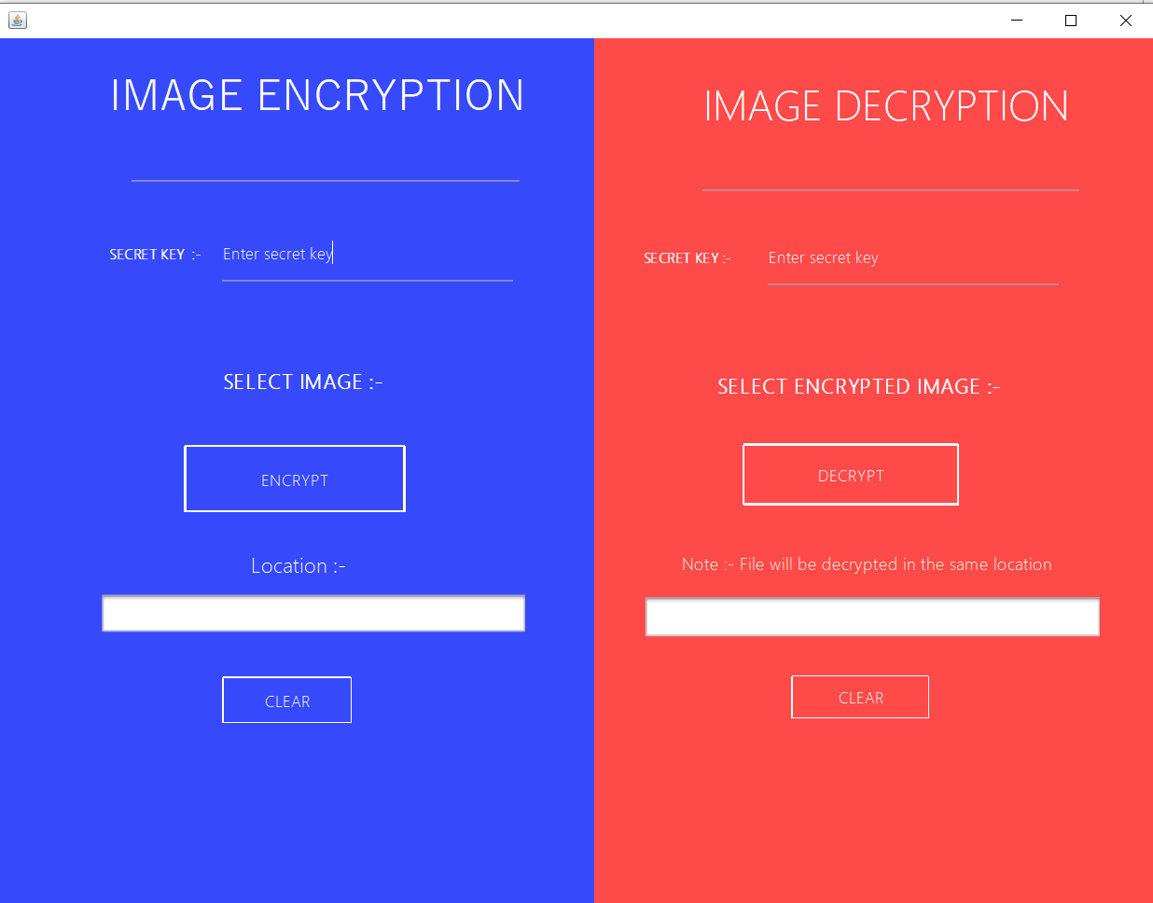
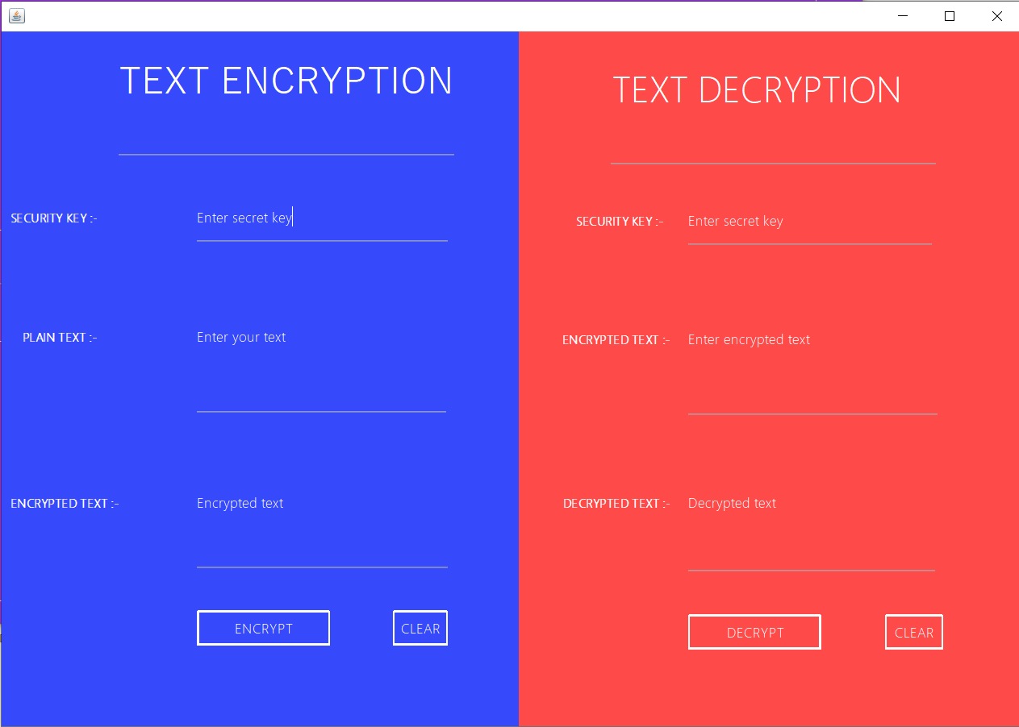
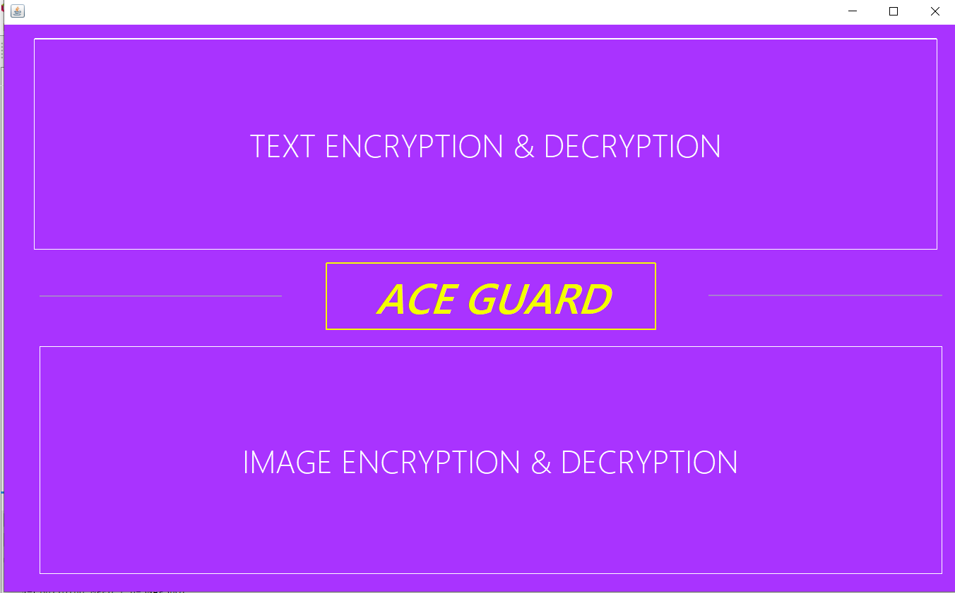
Usage of NetBeans in the Project :-
We used Java Swing to create the front end of our Java application.
These three are the Jframes used in the project java application which will further
demonstrate the use of AES Encryption and Decryption.

Slide 9
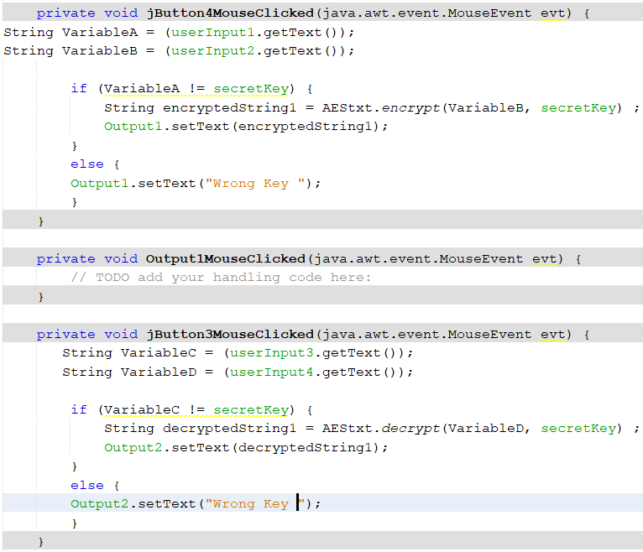
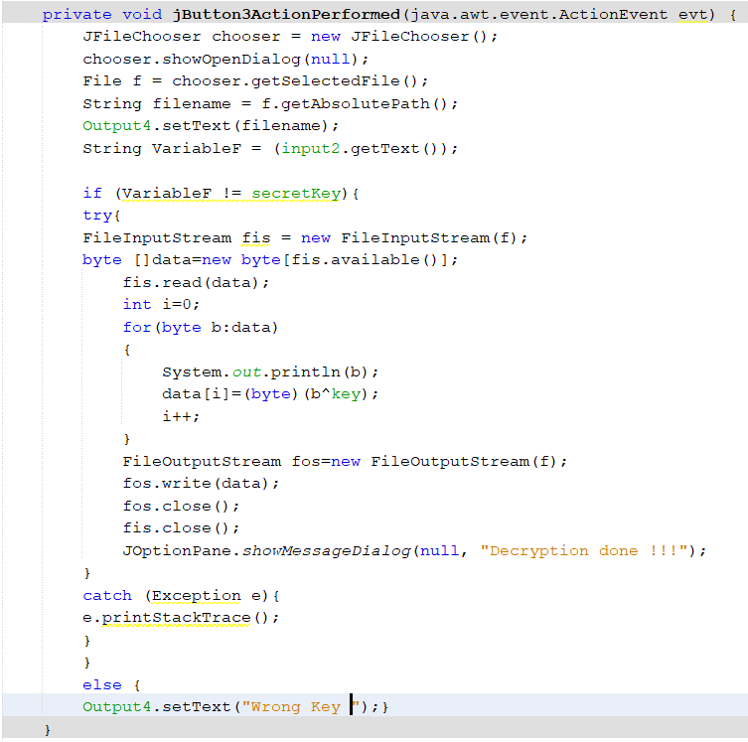
For Text encryption we created a Java class
For Encrypt-Decrypt using Base64 Encoder-Decoder
and import it in the required Jframe.
For Image Encryption & Decryption
we perform simple XOR operation .
XOR operation is performed between each and every
value of byte array and key due to which all data of
Image get change and due to which we are unable
to open our Image.

Slide 10
Future Scope :-
Key distribution is also one of the major aspect that should be taken care of.
As AES algorithm is a symmetric encryption technique that is single to be used by both the ends. We also have to find ways to securely share the key.
Key can be distributed in one of the following ways:
1. Physical transfer of the key from sender to receiver.
2. Key can also be delivered to sender and receiver with the help of trusted third party.
3. Key used by sender and receiver previously can be converted to new Key using Encryption.
4. Key can be provided to both users with help of KDC.

Slide 11
Thankyou

